Slide 1


Hovercraft
Division B/C
Georgia Tech Event Workshop Series 2025-26

Slide 2
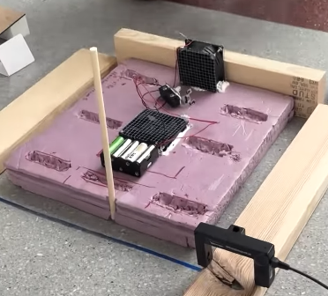
01
RULES SHEET
02
DIFFICULT TOPICS
03
COMMON QUESTIONS
04
TIPS FROM A VETERAN
05
OTHER FREE RESOURCES
Notes:
For Builds: Replace difficult topics with physical principles involved in the build and replace common questions with common designs

Slide 3
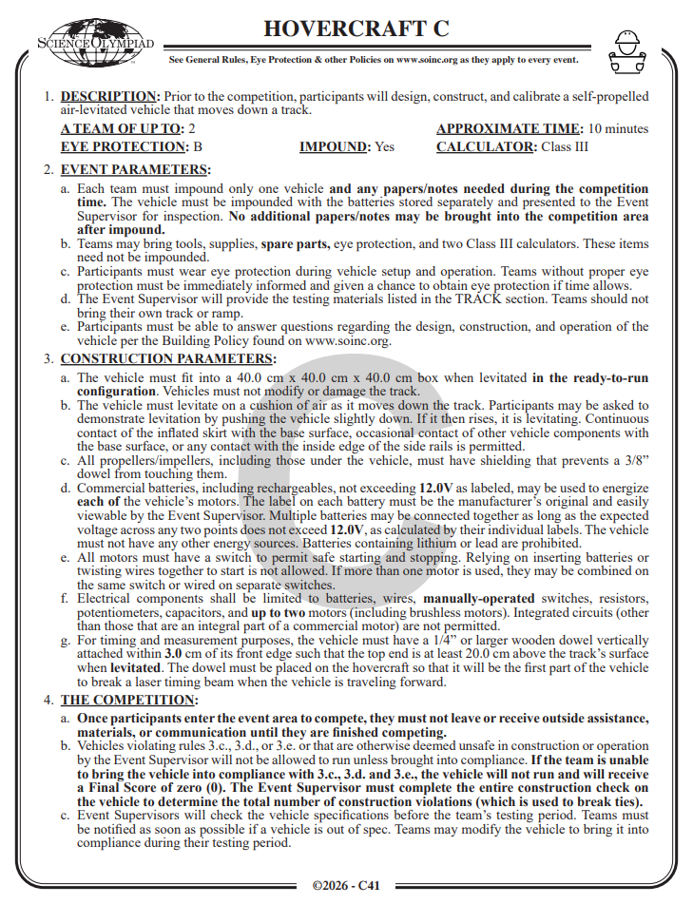
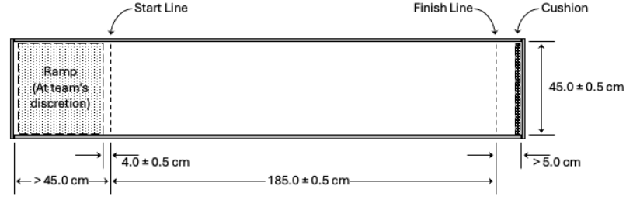
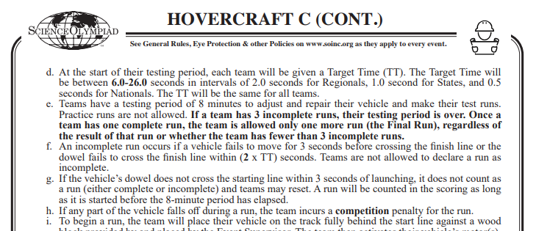
The Rules Sheet
Device: a self-propelled air-levitated vehicle that moves down a track
Goal: to run across the entire track from start to finish, meeting the target time
Track: 185cm long, 45cm start
Target Time: 6-26 sec (Div C), 10-20 sec (Div B)
Bonus: if 25% with TT of first run (Div B and C)

Slide 4
Design Specifications
Device: 40cm x 40cm x 40cm
Up to 2 motors with 2 fans
All propellers/impellers, including those under the vehicle, must have shielding that prevents a 3/8” dowel from touching them.
Must have a 1/4” or larger wooden dowel vertically attached within 3 cm of its front edge with the top end is at least 20.0 cm above the track’s surface when levitated.
Commercial batteries, including rechargeables, not exceeding 12.0V as labeled, may be used to energize each of the vehicle’s motors.
All motors must have a switch to permit safe starting and stopping. Relying on inserting batteries or twisting wires together to start is not allowed.
Notes:
Highlight key points from the rules sheet: DESIGN LOGS that basically grant free points, most tested-on topics, point distribution so that competitors know what to prioritize, allowed notes and equipment, etc.

Slide 5
Electrical Components
Batteries,
Wires
Manually-operated switches
Resistors
Potentiometers
Capacitors
Up to two motors (including brushless motors) are permitted.
Integrated circuits (other than those that are an integral part of a commercial motor) are NOT permitted (as well as anything not on the above list).
Notes:
Highlight key points from the rules sheet: DESIGN LOGS that basically grant free points, most tested-on topics, point distribution so that competitors know what to prioritize, allowed notes and equipment, etc.

Slide 6

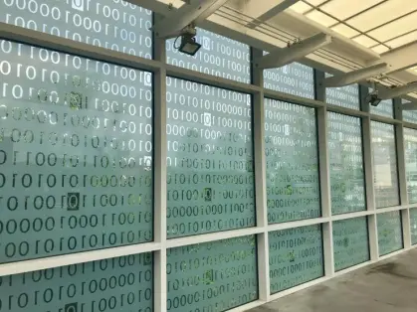
DIFFICULT TOPICS
Notes:
This section should focus on topics that are more math-based (harder to self-teach), concepts that come only usually up in college level courses, or concepts that you struggled with when you competed in this event

Slide 7
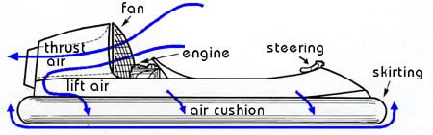
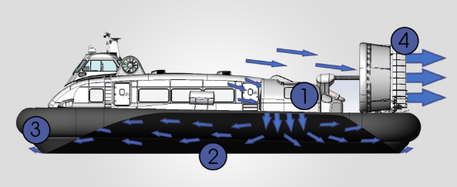
Topic 1: Design
FANS/MOTORS
One fan (distributing the air)
Two fan (independent)
SKIRTS:
Wall Skirt
Bag Skirt
Notes:
Feel free to add more topics and make sure that there are plenty of pictures/diagrams!

Slide 8
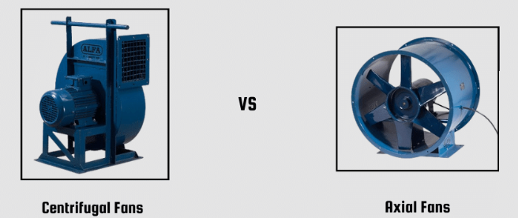
Topic 2: Fans
Lift Force
from the fan that blows down
Thrust Force
from the fan that propels the vehicle forward
High static pressure fans - good for moving air through tight spaces
Fans with high CFM - good for moving large quantities of air
Axial Fans - parallel wind direction (thrust)
Centrifugal Fans - perpendicular wind direction (lift)

Slide 9
Topic 3: Materials
Fans
Axial (thrust)
Centrifugal (lift)
Board
Styrofoam
3d Printed
Skirt
Plastic bags
Trash bags
What NOT to use:
Integrated circuits, transistors
Motors
Switches
Push buttons
Switches
Calibration devices
Variable Resistors
Masses
Notes:
Feel free to add more topics and make sure that there are plenty of pictures/diagrams!

Slide 10
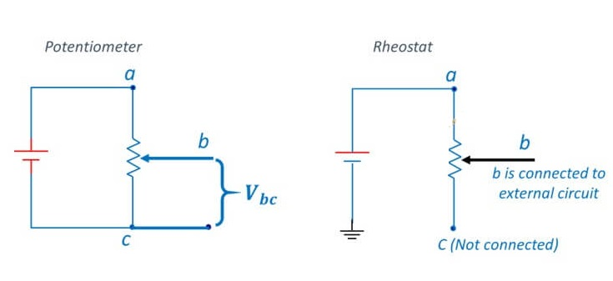
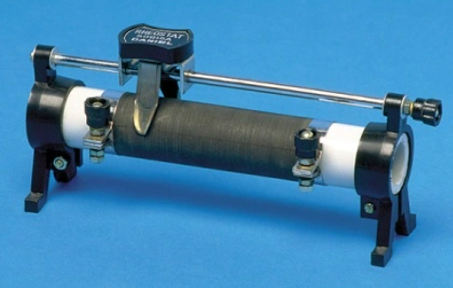
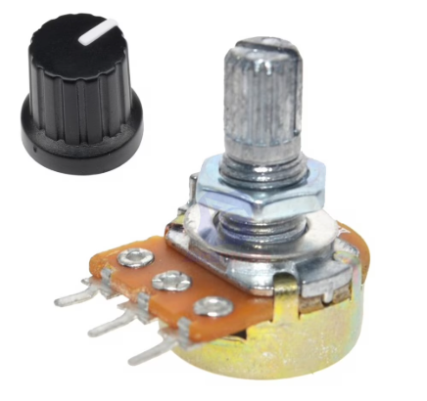
Topic 4: Circuitry
Resistors (control speed of fan)
Potentiometers (voltage control) → Series
Rotary
Linear
Rheostats (current control) → Parallel
Rotary
Sliding

Slide 11

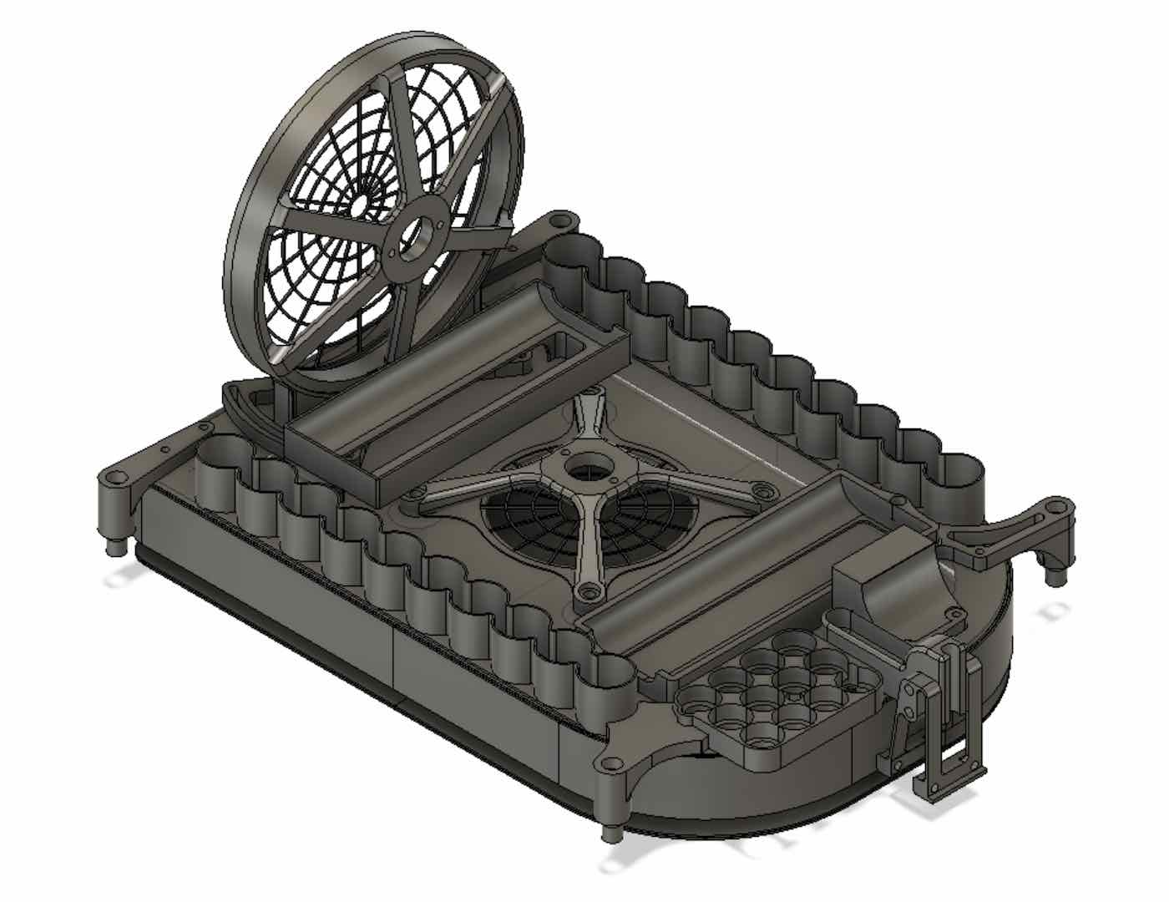
COMMON QUESTIONS
Common/general questions people have asked me in person or online this year.
Notes:
\

Slide 12
Question 1
What is the difference between a potentiometer and a rheostat other than how they’re connected in the circuit?
Answer: “A potentiometer is designed to control voltage, and a rheostat is designed to control current.”
Notes:
Pull some questions from exams on the scioly wiki test exchange, first give attendees a couple minutes to read over them/work through them, then walk them through the answers. Try to get a mix of multiple choice and short answer or matching

Slide 13
Question 2
Is a better to start off with a wall skirt or a bag skirt?
Answer: “I think it’s better to start off with a bag skirt to pass levitation. Wall skirts are great for future use, but often times wall skirts are sensitive to floor types and are harder to tell if they are truly levitating or not.”
Notes:
Pull some questions from exams on the scioly wiki test exchange, first give attendees a couple minutes to read over them/work through them, then walk them through the answers. Try to get a mix of multiple choice and short answer or matching

Slide 14
Question 3
“Can we use microcontrollers and/or program the vehicle?”
Answer: “No, the rules state that the competitor may not use any integrated circuits (unless they are an integral part of the motor) to control the vehicle.”
Notes:
Pull some questions from exams on the scioly wiki test exchange, first give attendees a couple minutes to read over them/work through them, then walk them through the answers

Slide 15
Tips from a Competitor
Always check shielding!
Always check dimensions!
Never test without goggles at home.
Keep track of where your wires are always, don’t short anything.
Try testing your circuitry separately from the hovercraft with a multimeter first.
Spend time on your skirt, make sure the balance is good.
Draw circuit diagrams!
Test on flat floors (check for incline).
Notes:
Use this section to talk about any strategies you used to navigate the event when you competed. For example, how did you manage your time, how did you organize your notes, how did you split topics up between you and your partner, etc.?

Slide 16
Additional Resources
Rules: Div C https://drive.google.com/file/d/14Pz2d5-TZEL2aLHbNzu2iJQLwHwKN6o7/view?usp=sharing
Div B
https://drive.google.com/file/d/1ZzFvmV52wORxycqJjibyBZlUKp2xM7Wg/view?usp=sharing
FAQS: https://www.soinc.org/hovercraft-div-c
https://www.soinc.org/hovercraft-div-b
Yes, Saturn is the ringed one. This planet is a gas giant, and it’s composed mostly of hydrogen and helium
Notes:
Here, you can link or mention any online or book resources that helped you in this event when you were a competitor. Try to avoid general resources like scioly wiki, because they probably already are familiar with it.

Slide 17
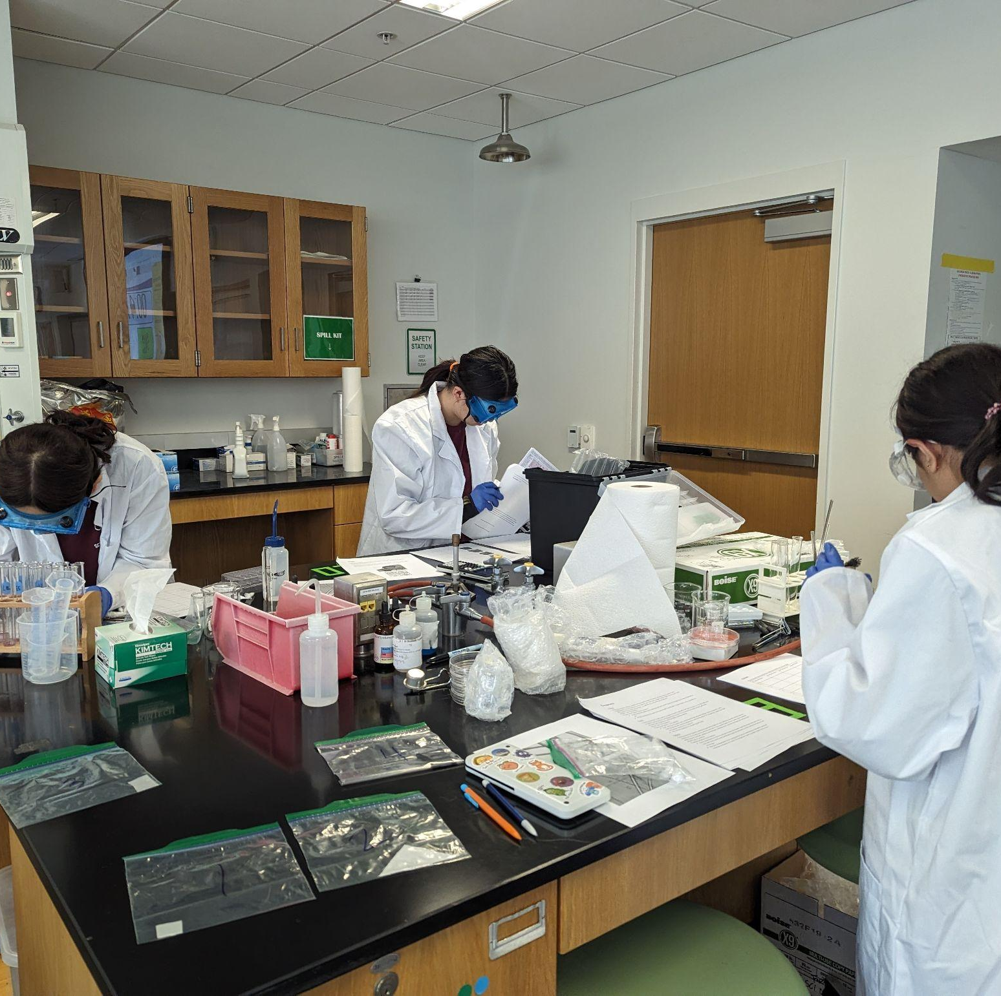
THANKS!
Notes:
(replace picture with a picture from one of our tournaments)

